Slide 1
Hawassa City Traffic Control And Management System
HU IOT SOI CS

Slide 2
Abstract
Develop web based management system with Android app for Hawassa traffic control and management
provides simple and effective way of controlling and managing traffic

Slide 3
Introduction
RTA
Founded in 1967 as Road Transport Administration
1976 – Restructured as RTA
Ensure the provision of a modern, integrated and safe Road transport services
Control driver’s license
Register Vehicle information

Slide 4
Statement of The Problem
Manual Data handling
Difficulty in searching and updating data
Exposed to Disaster,
Not Efficient
Car Accident by illegal drivers with Fake License
Notes:
Not Efficient
Data Redundancy
Data integrity
File could be lost

Slide 5
General Objective
Develop
user friendly,
easily accessible
centralized
Computerized Traffic Control and Management System
Notes:
To change the manual system into computerized System and
develop a user friendly system that avoids the need for unnecessary physical interaction with the document

Slide 6
Specific Objective
To Perform Requirement analysis
To Design the system with Object Oriented Approach
To Deploy the system
Notes:
To make document analysis about traffic management and control system.
To perform a requirement analysis to find out the system functional and nonfunctional requirements.
To Design the system using object-oriented models for understanding the system and to make the implementation easy.
To Design the database for storing data related to Driver, Traffic police and Vehicle using MySQL.
To avoid data redundancy and to keep data secured
To save resource
To develop Mobile app for traffic police to easily manage and control driver license
To ease data modification like adding, updating and editing user record
To create better working environment
To deploy the system

Slide 7
Ctd…
Design the database for storing data related to Drivers and Vehicles
Develop Mobile app for traffic police to easily manage and control driver license
Notes:
To make document analysis about traffic management and control system.
To perform a requirement analysis to find out the system functional and nonfunctional requirements.
To Design the system using object-oriented models for understanding the system and to make the implementation easy.
To Design the database for storing data related to Driver, Traffic police and Vehicle using MySQL.
To avoid data redundancy and to keep data secured
To save resource
To develop Mobile app for traffic police to easily manage and control driver license
To ease data modification like adding, updating and editing user record
To create better working environment
To deploy the system

Slide 8
Scope
Applied on Hawassa city Transport Authority
Store and Provide information about Traffic Polices, Drivers, Vehicles
Users
Traffic Polices
RTA Employee
Drivers

Slide 9
Limitation
Only For Hawassa City
Support only Android Mobile Phones
Doesn’t support Local Languages
Doesn’t Record Detailed Accident information
Need Network Coverage

Slide 10
Tools and Methodology

Slide 11
Tools in Documentation
Microsoft Visio
Astah UML
Adobe Photoshop
Pencil Draw (xulrunner)

Slide 12
Tools in Implementation
WAMP
Jet Brains PhpStorm
Android Studio

Slide 13
Programming and Scripting Languages
Front-End
Back-End
PHP
HTML5
CSS and Bootstrap
JQuery
AJAX
Java
Notes:
Framework – Bootstrap
Library – JQuery,
Scripting – CSS, AJAX, Javascript
Language- Java, PHP, HTML5

Slide 14
Hardware tools
PC
Android Phone
Web Server
NAS

Slide 15
Methodology
Data collection
Site Observation
Open Interview
Document Analysis
Object Oriented Approach

Slide 16
System Requirement Analysis
Ch 2

Slide 17
Existing System
Manual Data Handling
Give Driver’s License
Record Traffic Accident Details
Record and Update Vehicle Information

Slide 18
Problems of Existing System
Performance
Information handling
Data Storage
Efficiency
Security

Slide 19
Proposed System
Web and Mobile Application
Easy for both beginners and advanced user
user-friendly and attractive user interface, combined with strong searching, Insertion and reporting capabilities

Slide 20
Requirement Analysis

Slide 21
Functional Requirement
Web Application
Mobile App
Register Employee, Vehicle & Driver
Register Traffic Police
Manage Employee, Vehicle & Driver Profile
Manage Traffic Police Profile
Generate Report
Control Fake Driver License
View Driver profile
View Vehicle Information
Register Accident
Punish Driver
Notes:
Manage – View, Change, Enable/Disable,

Slide 22
Non-Functional Requirement
Usability
Security
Performance
Availability

Slide 23
System Modeling: OO Design
Ch 3

Slide 24
System Use case
Administrator
Employee
TPA
Traffic Police
Driver

Slide 25
Use Case Diagram

Slide 26
Punish Driver Use Case Description

Slide 27
Generate Report Sequence Diagram

Slide 28
Activity Diagram
Enable/Disable User Account

Slide 29
Class Diagram

Slide 30
System Design
Ch 4

Slide 31
Proposed System Architecture
Has Three Tier Architecture
Presentation
Logical
Database Access

Slide 32
System Architecture

Slide 33
Deployment Diagram
Notes:
Deployment diagrams show the configuration of run-time processing elements and the software components, processes, and objects that live on them. Software component instances represent run-time manifestations of code units.

Slide 34
User Interface Prototyping
Navigation Tree
Graphical UI
Web interface
Android App

Slide 35
Navigation Tree - Web

Slide 36
GUI - Web

Slide 39
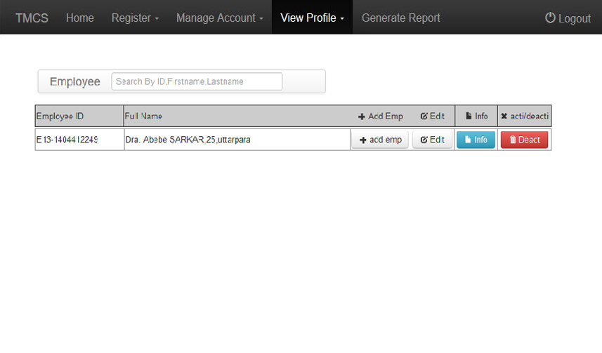

Slide 40
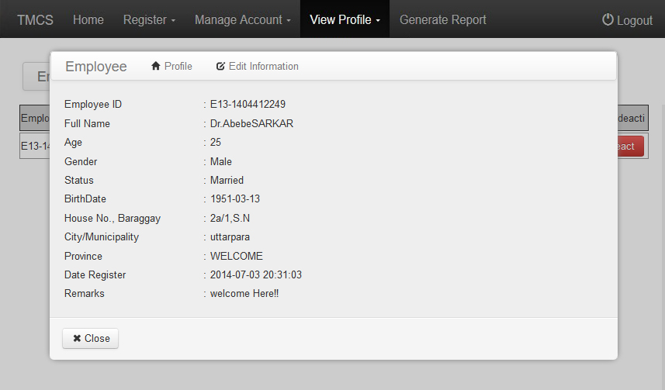

Slide 41
Navigation Tree – Android App

Slide 42
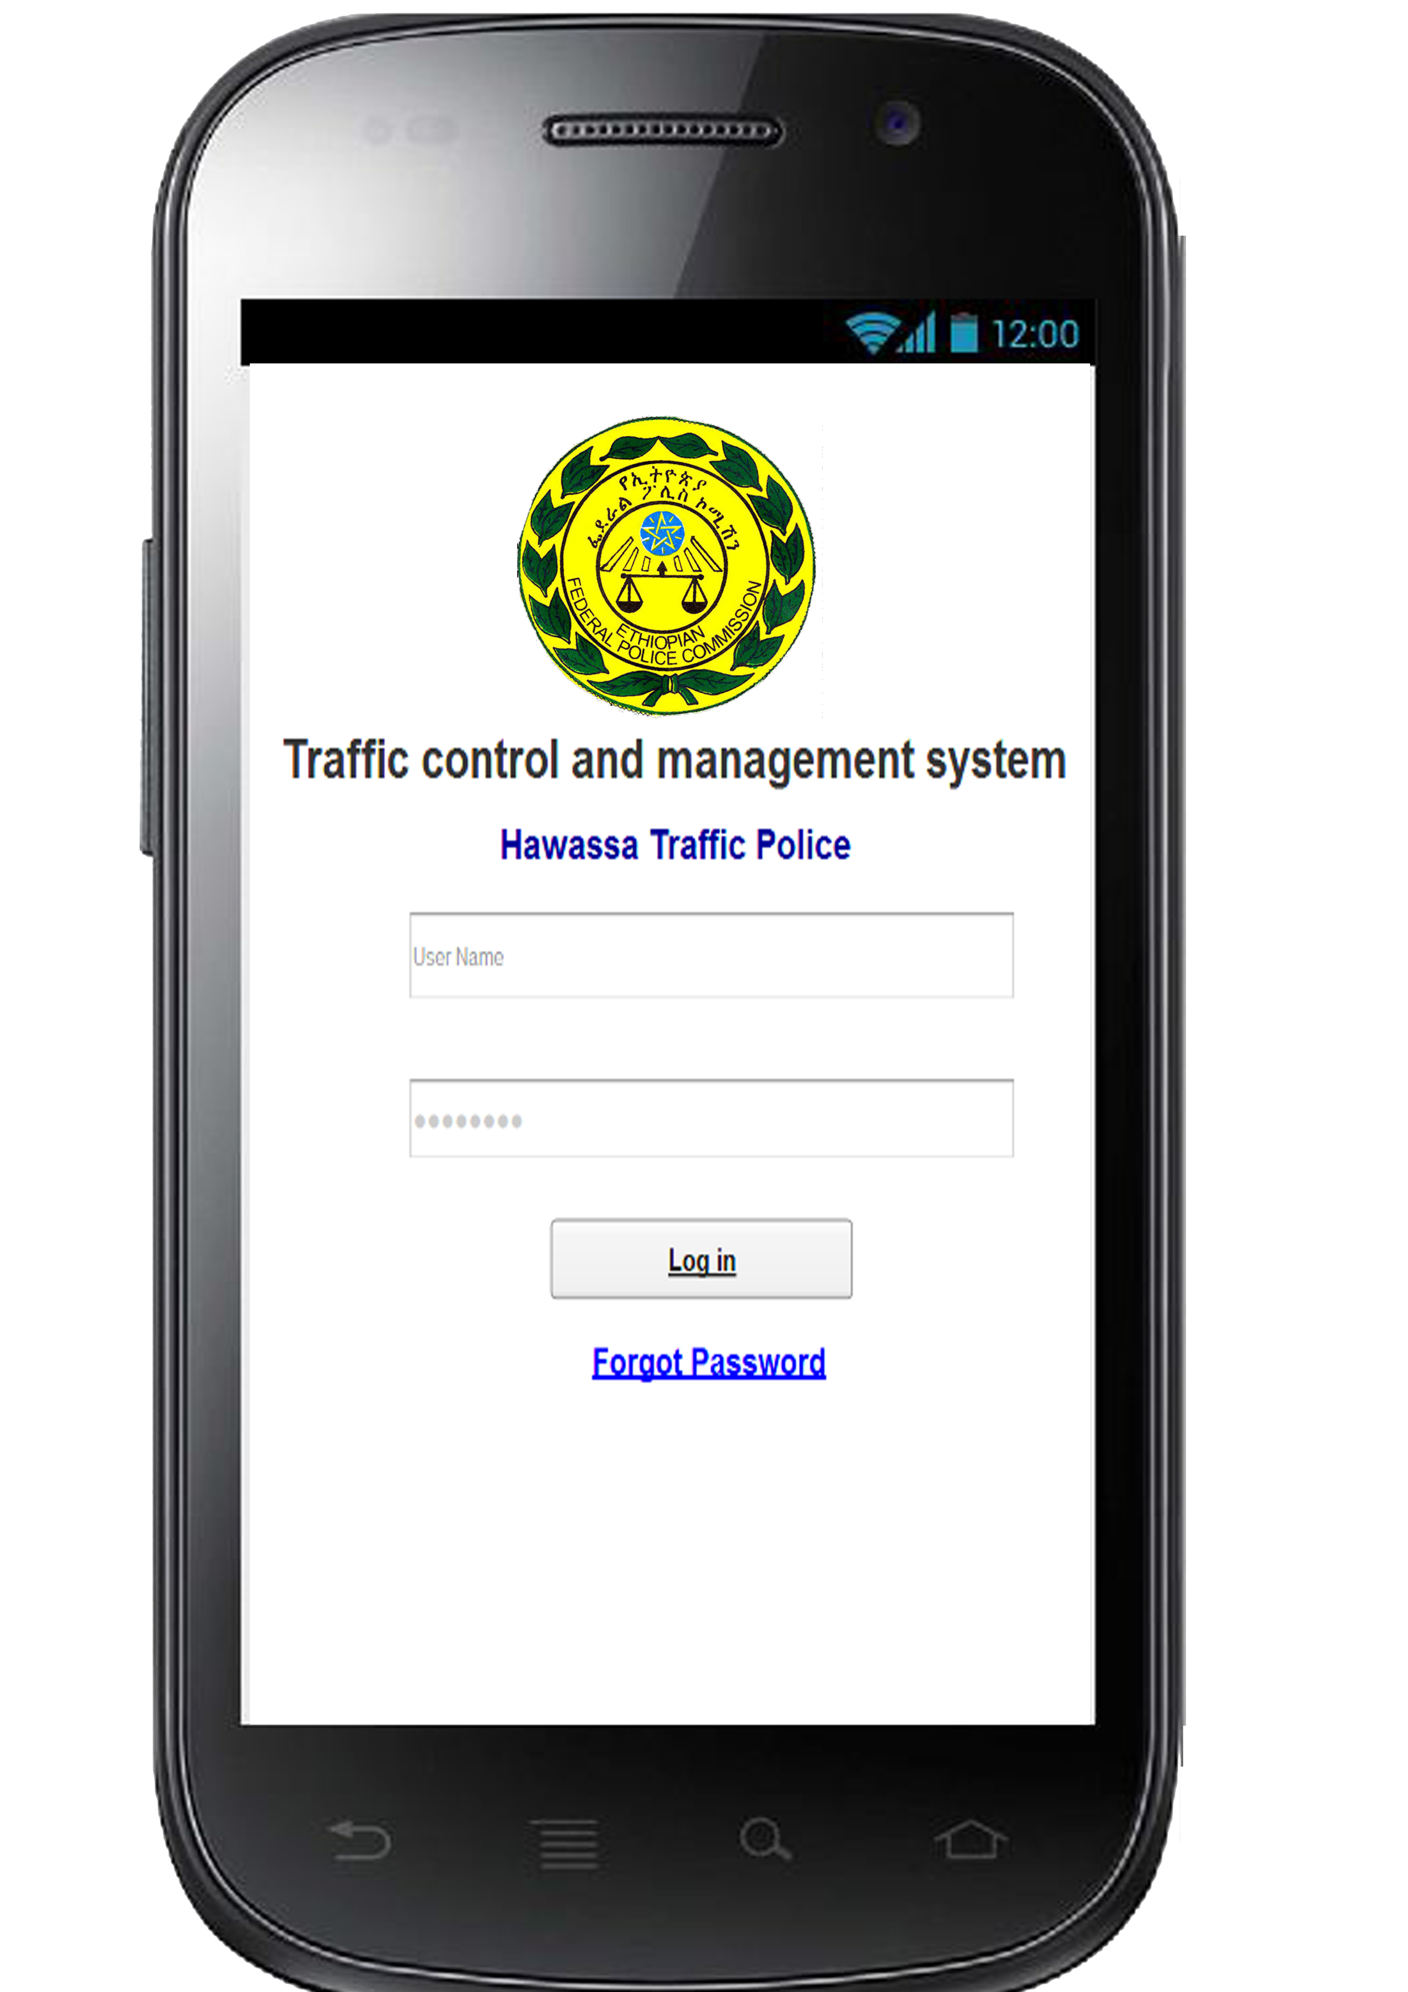
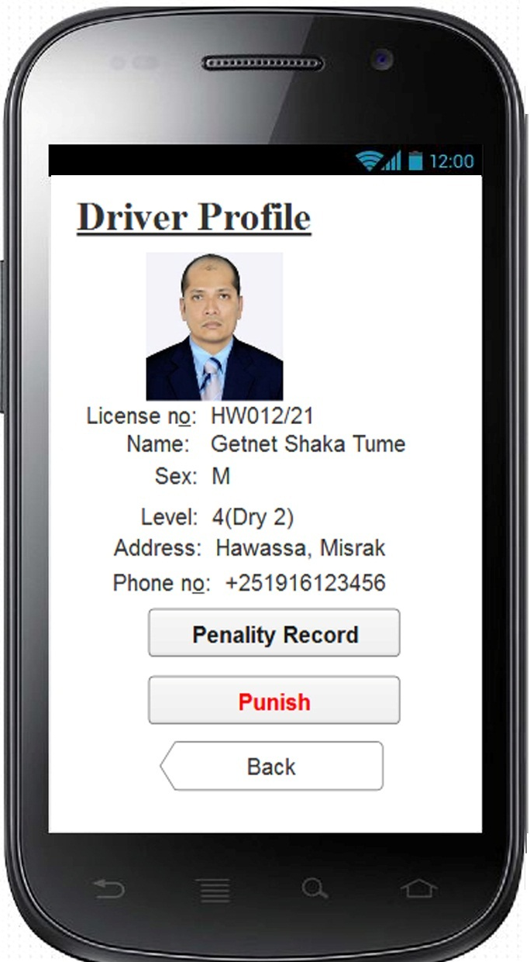
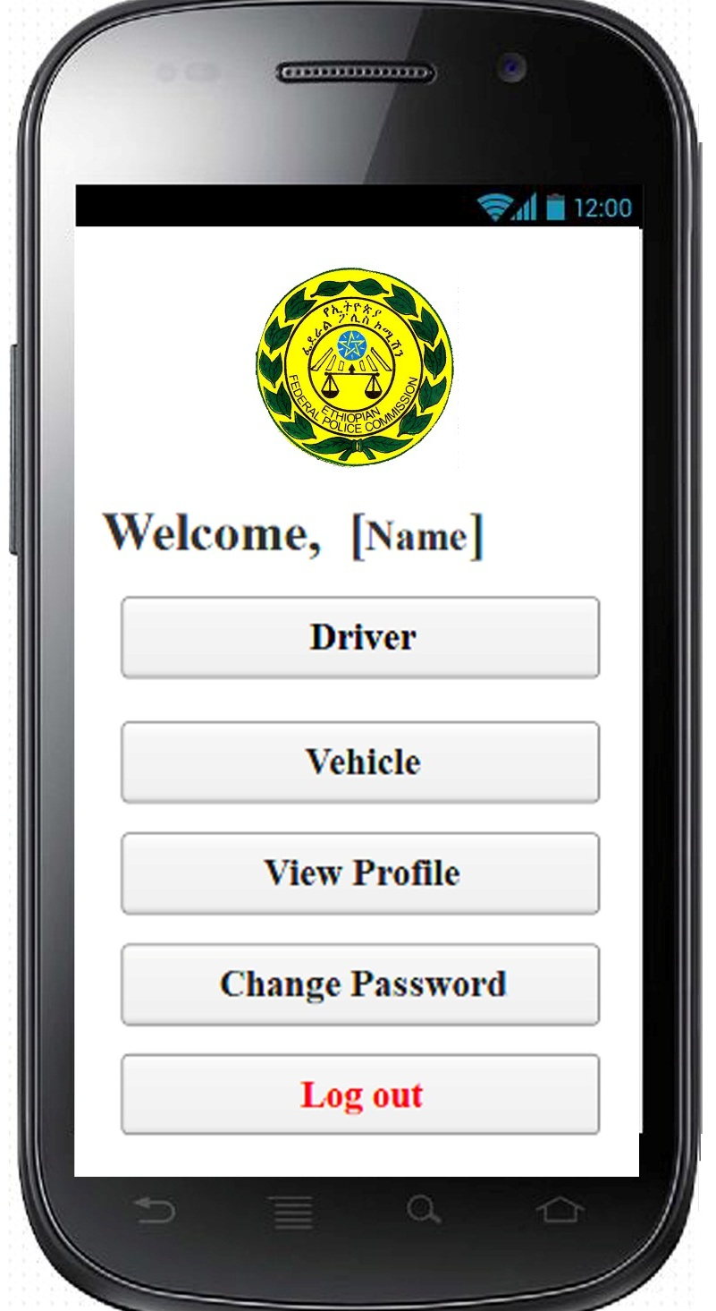
GUI – Android App

Slide 43
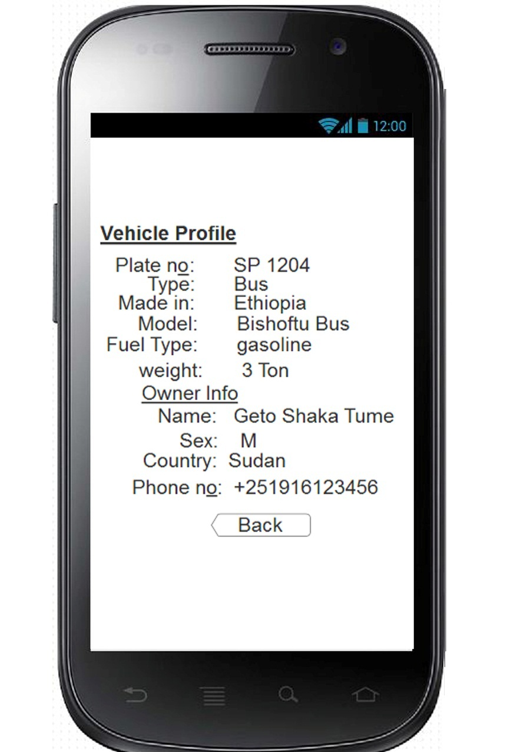
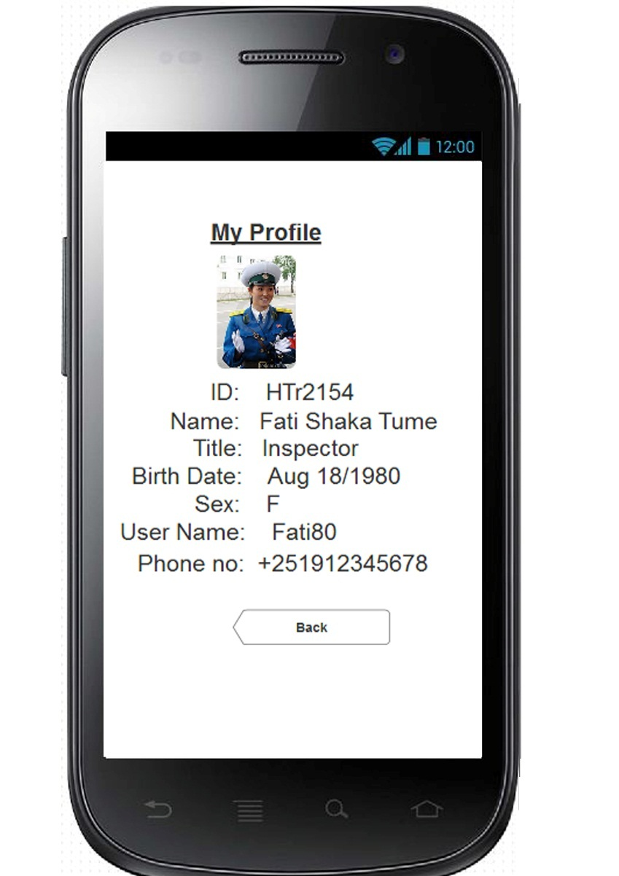
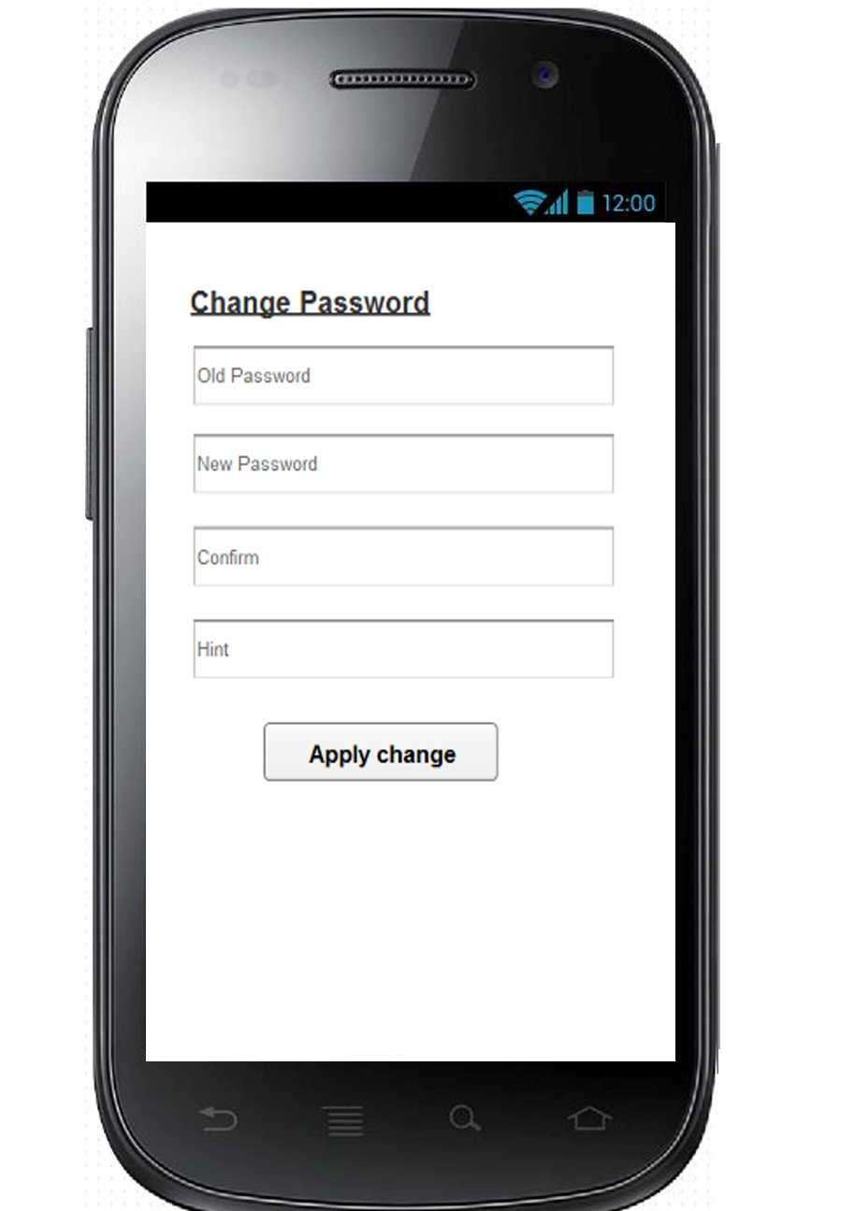

Slide 44
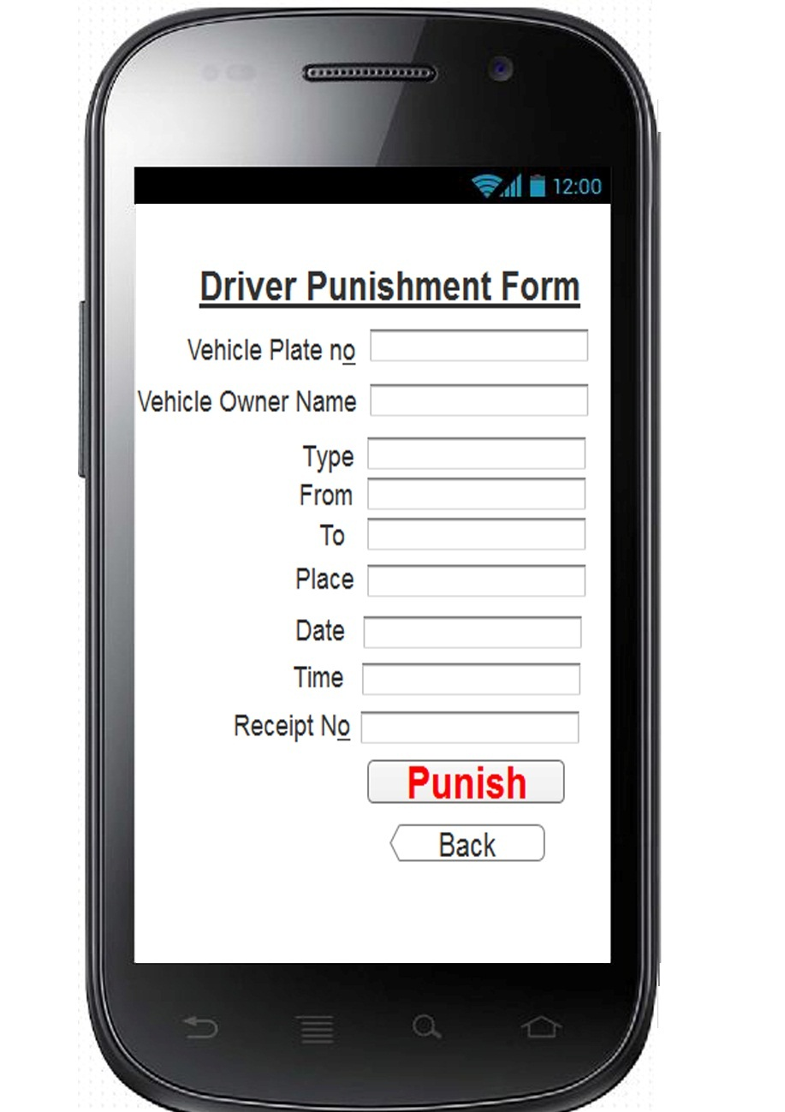

Slide 45
Database Design

Slide 47
Normalization and Schema Design

Slide 48
10 Q for your Patience

